Slide 1
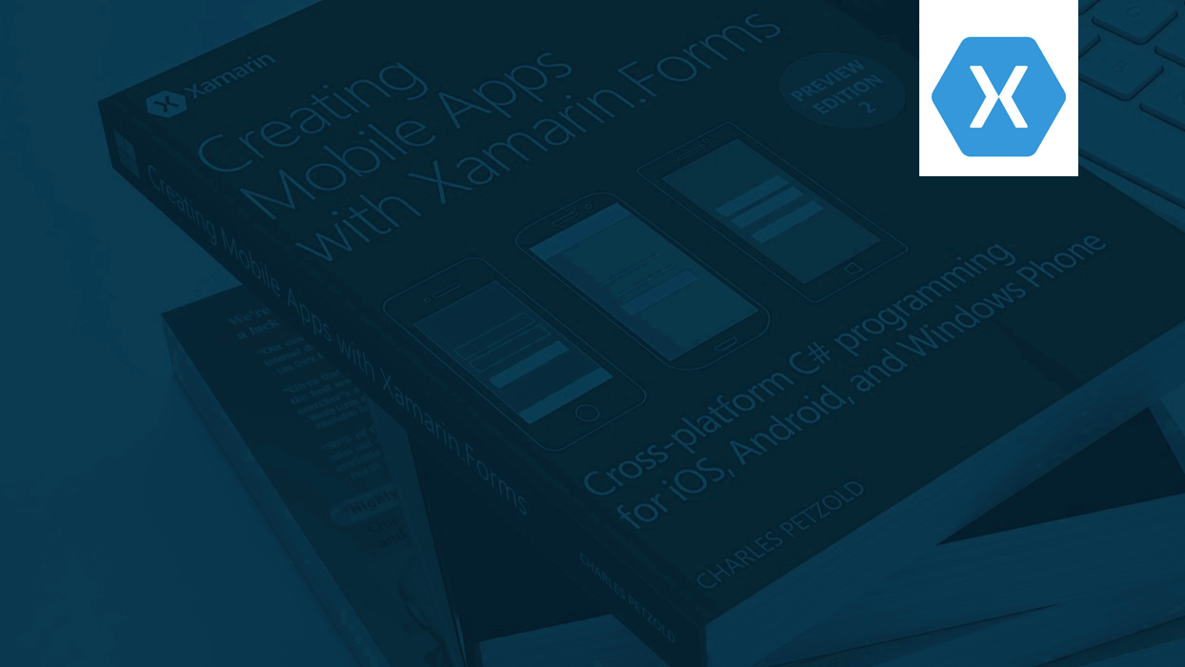

Oslo Xamarin Meetup
Xamarin App Kickoff –Workshop Series no. 1
By Monica B. Tvedt, 10.01.2018

Slide 2
Agenda
Building a complete Xamarin.Forms App. Learning multiple subjects such as Azure Mobile Apps, Offline data Sync, user authentication, storage, visualization, layout, sharing, Push notifications, CI/CD with AppCenter and more. Level: All (from Beginner to Advanced)
Welcome & "Xamarin App Workshop Series" Introduction
Coffee Break & Around the table discussion
Hands-on Workshop
Project Setup
Azure Mobile Apps

Slide 3
MONICA B. TVEDT, AVDELINGSLEDER
For Sopra Steria sin Microsoft .NET avdeling og deres DevOps & Microservices avdeling
TIDLIGERE
Head of UMS Innovation center at Unified Messaging Systems ASA
Head of SaaS Development at Unified Messaging Systems ASA
Senior Software Engineer Consultant, Webstep AS
Software Engineer, Cellvision AS
Gründer
UTDANNELSE
Boston University Business & Management, Digital Leadership Business & Management, Digital Product Management
University of Bergen & Bergen University College Dataingeniør, Master Software Engineering - CERN
ARTIKLER & INTERVJUER
Thinking big – while covering the smaller needs
Små partikler – Store datamengder Dagens Næringsliv
App development, Xamarin Test Cloud & Continuous Integration
ANDRE ROLLER
Microsoft .NET Meetup Owner at Sopra Steria, Oslo Xamarin Meetup Organizer, Bergen Xamarin Meetup Organizer, Investing & Trading Community Owner at Sopra Steria
INTERESSER/AKTIVITETER
Sjakk, tennis og programmering

Slide 4
"My new years resolution" app for keeping track of our 2019 goals and our progress through the year.
Azure Mobile Apps
Offline data Sync
User authentication
Storage
Visualization
Sharing
Push notifications
CI/CD
Xamarin App Workshop Series

Slide 5
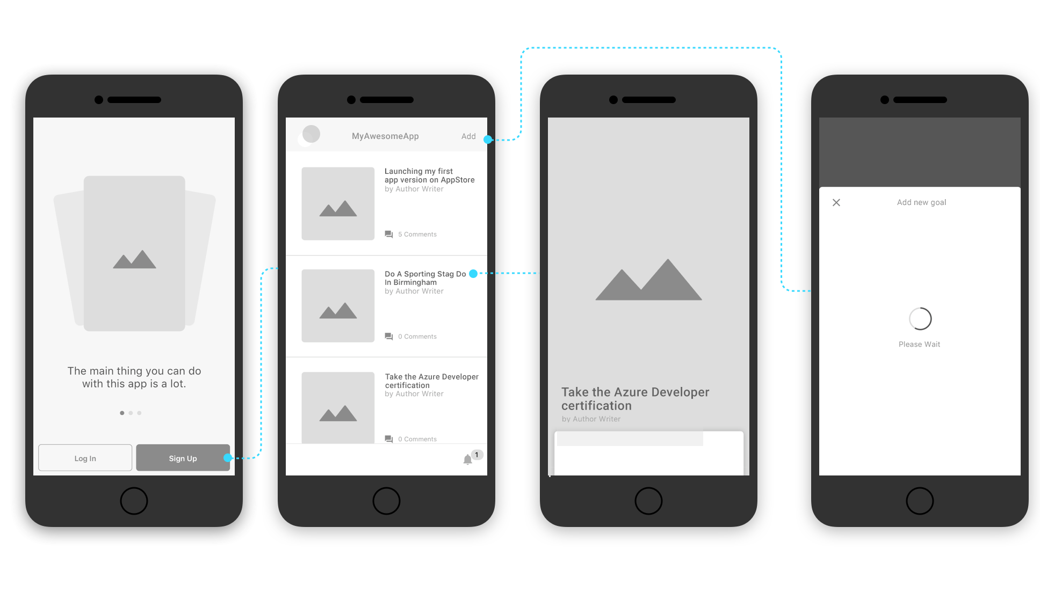

Slide 6
Azure Mobile Apps
Use offline data sync to build responsive apps
Broadcast personalized push notifications to millions in minutes
Social integration with Facebook, Twitter, Google
Single sign-on with Azure Active Directory

Slide 7
Azure – Mobile Apps
Sign up for Microsoft Azure
You need an Azure account to complete this tutorial. You can:
An active Azure account. If you don't have an account, you can sign up for an Azure trial and get up to 10 free mobile apps that you can keep using even after your trial ends. For more information, see Azure Free Trial.
Activate Visual Studio subscriber benefits. Your Visual Studio subscription gives you credits every month that you can use for paid Azure services.
Creating a new Mobile Apps Backend
Search for “Mobile Apps” in the Azure Portal, click “Mobile Apps Quickstart”, and then select Create.
Configure the server project
Click the App Services button, select your Mobile Apps back end, select Quickstart, and then select your client platform (Xamarin). Create a new SQL database and server. select Node.js for Backend language

Slide 8
Workshop: Creating our initial App
Create a new Xamarin.Forms project named «XamGoals»
From top menu in Visual Studio: File > New > Project
Select «installed» > «Visual C#» > «Cross-Platform» > «Mobile App (Xamarin.Forms)»
Define the project name and solution name befor clicking «OK»
Next, select the template «Blank» and choose your platforms (iOS and/or Android). Code sharing strategy is set to .NET standard.
Click «OK» and your project will be created.
Find assets and sample code for this app on GitHub: https://github.com/StargrrlMoonlight/Oslo-Xamarin-Meetup

Slide 9
Workshop: Install NuGet Packages
We will use the following NuGet packages:
CarouselView.FormsPlugin – for our onboarding view
Microsoft.Azure.Mobile.Client
Microsoft.Azure.Mobile.Client.SQLiteStore
In addition, these NuGet packages also install their own dependencies.

Slide 10
Workshop: Creating our Startup Page
Remove the MainPage.Xaml page
Add the following folders: Views, Services, Repositories, Models, UIControls
Create a new content Xaml page «OnboardingPage» and place it inside the «Views» folder.
Open App.xaml code-behind-file and change: «MainPage = new MainPage();» to «MainPage = new OnboardingPage();» and add «using XamGoals.Views;» at the top.
Run the App to verify

Slide 11
Workshop: Creating our Onboarding Layout
<ContentPage xmlns:cv="clr-namespace:CarouselView.FormsPlugin.Abstractions;assembly=CarouselView.FormsPlugin.Abstractions">
<Grid Padding="0,32,0,30">
<Grid.RowDefinitions>
<RowDefinition Height="*" />
<RowDefinition Height="50" />
</Grid.RowDefinitions>
<Grid.ColumnDefinitions>
<ColumnDefinition Width="1*" />
<ColumnDefinition Width="1*" />
</Grid.ColumnDefinitions>
</Grid>
</ContentPage>
//complete code can be found at github: https://github.com/StargrrlMoonlight/Oslo-Xamarin-Meetup

Slide 12
Task 1: Create a custom Button control «RoundedButton

Slide 13
Workshop: Adding our sign in buttons
Task 1: Create a custom Button control «RoundedButton» and place it in the UIControl folder. Add xmlns:custom="clr-namespace:XamGoals.Controls« to the ContentPage tag.
<Grid Padding="0,32,0,30">
….
<Grid.ColumnDefinitions>
<ColumnDefinition Width="1*" />
<ColumnDefinition Width="1*" />
</Grid.ColumnDefinitions>
<custom:RoundedButton Margin="20,0,0,0" Grid.Row="1" Grid.Column="0" HeightRequest="40" Text="Log in" Clicked="OnLogInTapped"/>
<custom:RoundedButton Margin="0,0,20,0" Grid.Row="1" Grid.Column="1" HeightRequest="40" Text="Sign Up" />
//complete code can be found at github: https://github.com/StargrrlMoonlight/Oslo-Xamarin-Meetup

Slide 14
Task 2: Creating our onboarding cards
Using https://github.com/alexrainman/CarouselView

Slide 15
Workshop: Using the CarouselView
In your iOS and Android projects (AppDelegate & MainActivity) call: Xamarin.Forms.Init(); CarouselViewRenderer.Init();
XAML: First add the xmlns namespace: xmlns:cv="clr-namespace:CarouselView.FormsPlugin.Abstractions;assembly=CarouselView.FormsPlugin.Abstractions«
Then add the xaml above our sign-in buttons:
<cv:CarouselViewControl Grid.Row="0" Grid.ColumnSpan="2" Grid.Column="0" x:Name="OnboardingCarousel" ShowIndicators="true" IndicatorsTintColor="#dddddd" CurrentPageIndicatorTintColor="#8b8b8b" IndicatorsShape="Circle" InterPageSpacing="0">
<cv:CarouselViewControl.ItemsSource>
<x:Array Type="{x:Type x:String}">
<x:String>Onboarding card number one. Your main selling point!</x:String>//add as many as you like
</x:Array>
</cv:CarouselViewControl.ItemsSource> <cv:CarouselViewControl.ItemTemplate>
<DataTemplate>
<Grid Padding="32,32,32,64"> //add your onboarding elements such as images and text </Grid></DataTemplate></cd:CarouselViewControl> …

Slide 16
Task 3: create our main colors as resources in App.xaml

Slide 17
Next meetup: Creating our list of goals and syncronizing offline data.

Slide 18
Upcoming meetups: Adding Authentication, Adding Push notifications, Sharing with others.

Slide 19


Slide 20
Thanks for watching
www.soprasteria.no

